Slide 1
Antennas for Drone Array
Advisor: Shih-Yuan Chen
Student: Yun-Ting Tsai
Presentation Date: 2021/03/04

Slide 2
Outline
Slot Antennas
Patch Antennas
Spiral Antennas
Loop Antennas
Monopole Antennas
Conclusions

Slide 3
Outline
Slot Antennas
Patch Antennas
Spiral Antennas
Loop Antennas
Monopole Antennas
Conclusions

Slide 4
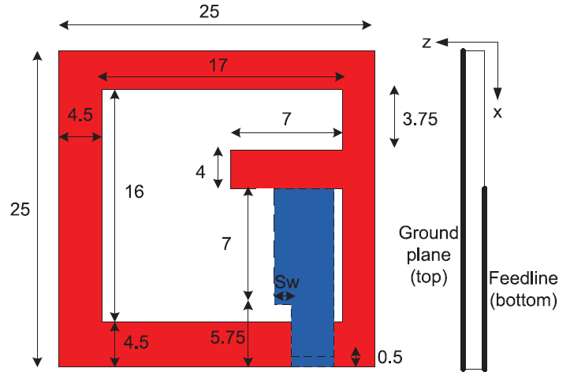
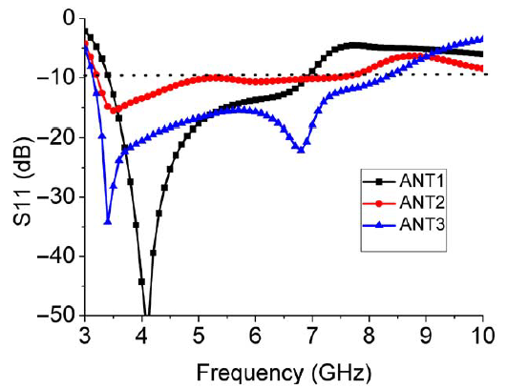
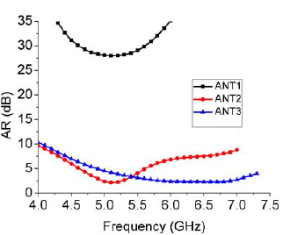
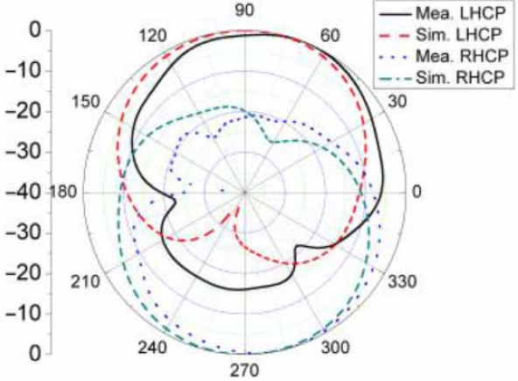
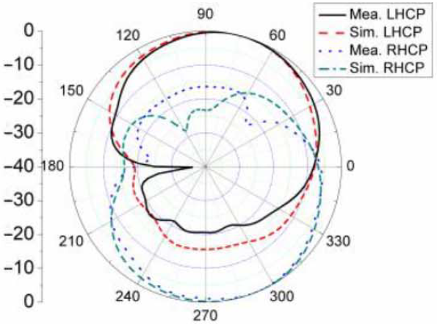
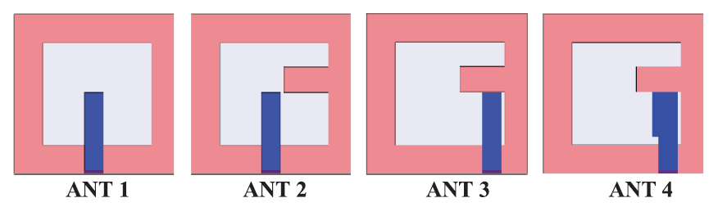

Slot Antenna (Bidirectional, Single Layer)
A Novel Simple and Compact Microstrip-Fed Circularly Polarized Wide Slot Antenna With Wide Axial Ratio Bandwidth for C-Band Applications, 2016
Gain: 4.5 dBi, Impedance BW ($S_{11}$< -10 dB): 90.2%, 3 dB-AR BW: 40%
horizontal strip → $E_{HOR}$
gap → reduce coupling
Sw → improve BW

Slide 5
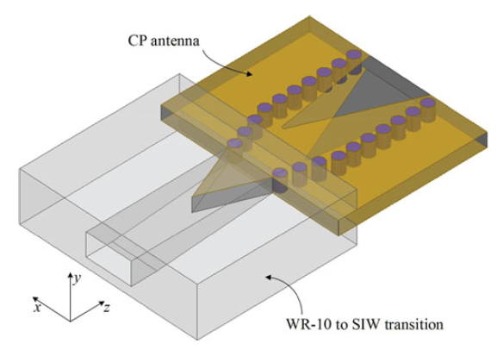
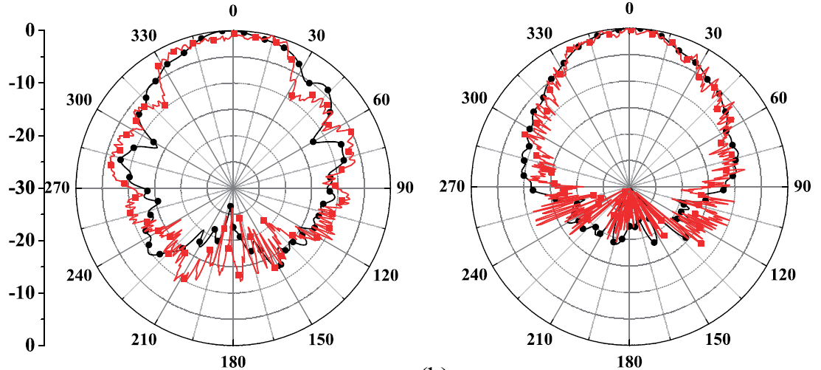
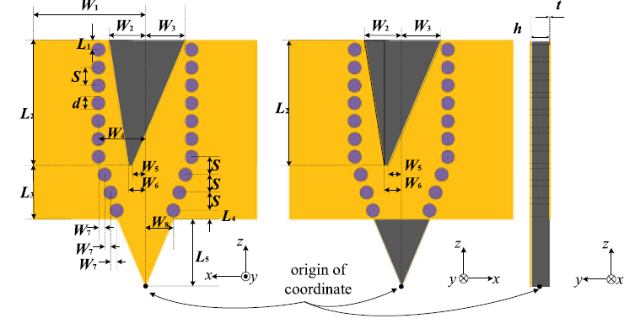
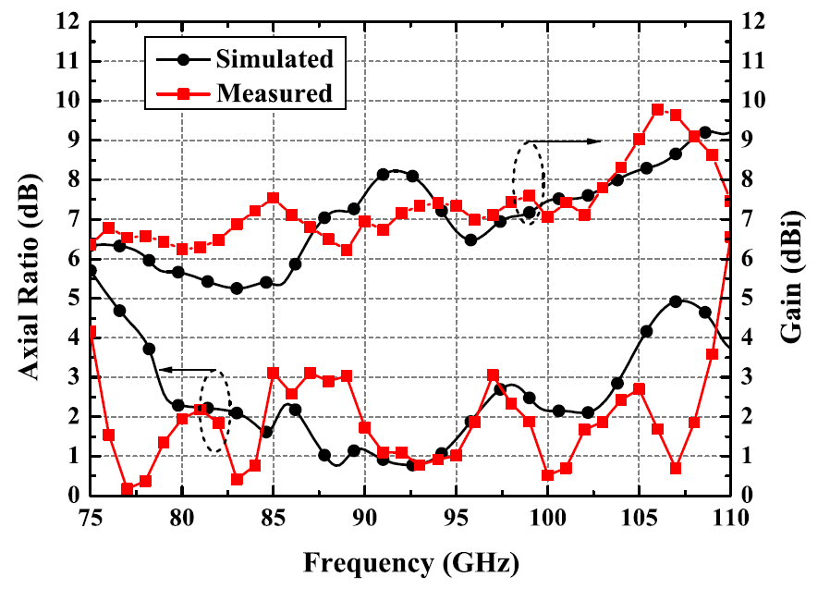

Slot Antenna (Endfire, SIW)
Circularly Polarized Substrate-Integrated Waveguide Tapered Slot Antenna for Millimeter-Wave Applications, 2017
Gain: 7.9 dBi, Impedance BW (VSWR < 2): 29.67%, 3 dB-AR BW: 29.67%
slot → $E_{x}$, via → $E_{y}$
h → amplitude of E
$W_{4}$ → phase difference
d → AR performance

Slide 6
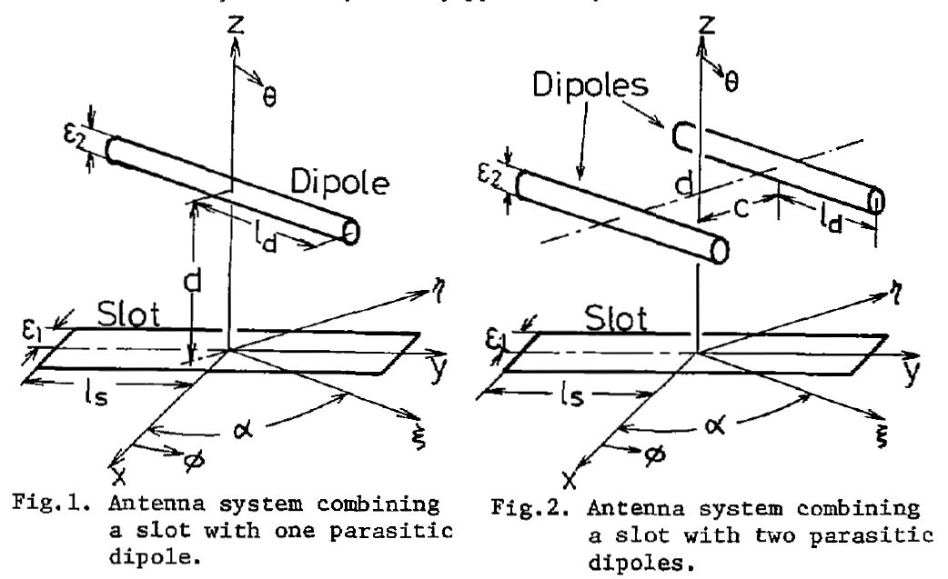
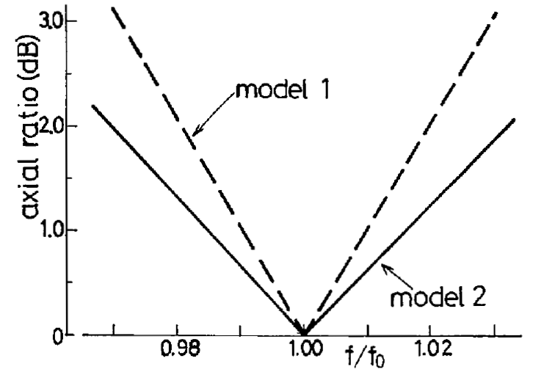
Slot Antenna with Dipole Antenna (Preview)
Novel Circularly Polarized Antennas Combing A Slot With Parasitic Dipoles, 1980
Linear-to-CP convertor

Slide 7
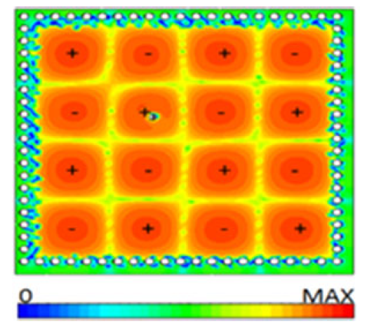
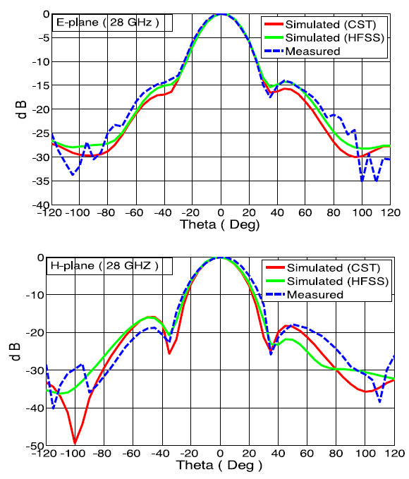
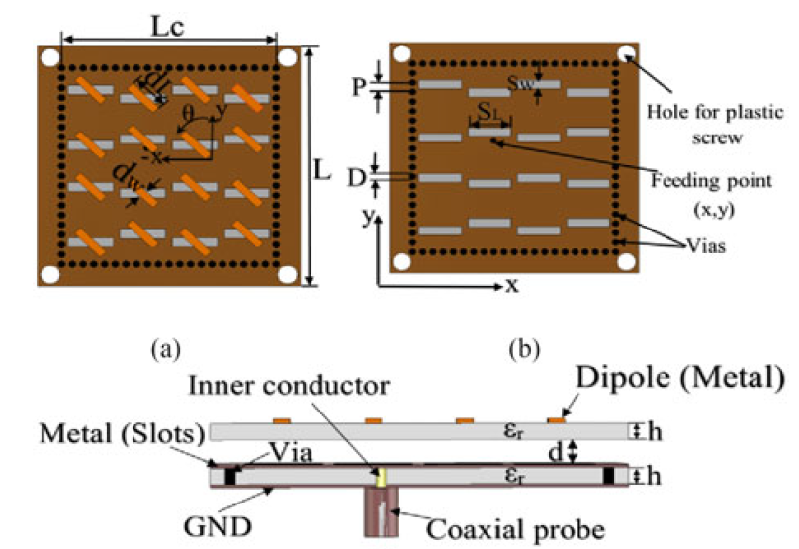
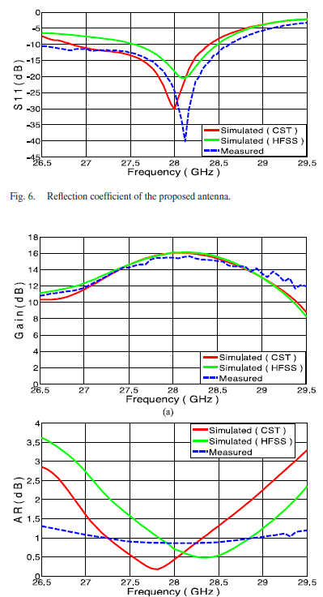


Slot Antenna with Dipole Antenna (Unidirectional, SIW)
High-Gain Low-Profile Circularly Polarized Slotted SIW Cavity Antenna for MMW Applications, 2017
Gain: 16 dBi, Impedance BW ($S_{11}$< -10 dB): 4.6%, AR: almost < 1.6 dB
${TE}_{440}$mode @ 28 GHz
d → resonance f
$d_{L}$ → AR & matching

Slide 8
Outline
Slot Antennas
Patch Antennas
Spiral Antennas
Loop Antennas
Monopole Antennas
Conclusions

Slide 9
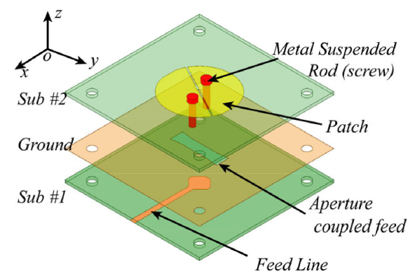
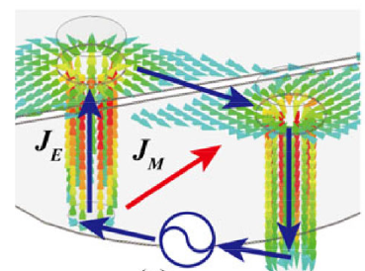
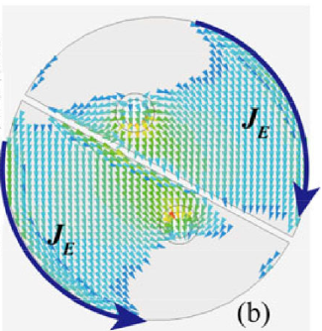
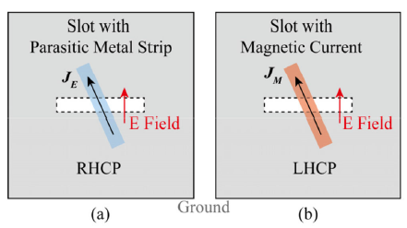
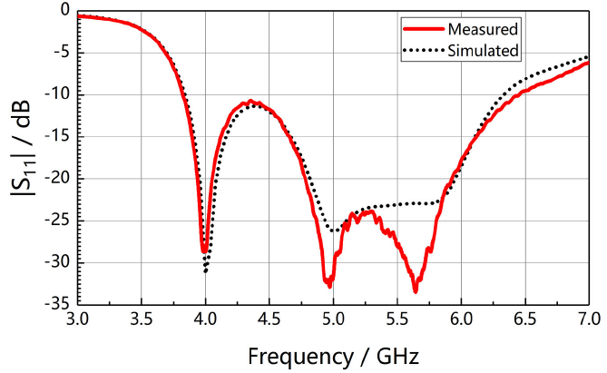
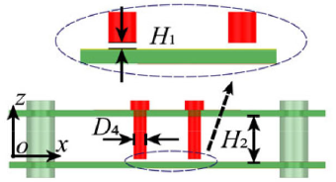


Patch Antenna with Slot (Unidirectional, 2 Layers) (1/2)
Wideband Circularly Polarized Split Patch Antenna Loaded With Suspended Rods, 2021
Gain: > 8 dBic, Impedance BW ($S_{11}$< -10 dB): 48.75%, 3 dB-AR BW: 22.58%
$H_{1}$→ better excitation & impedance matching
tilted angle → amplitude of E
height → phase difference
$f_{L}$ → slot & patch
$f_{H}$ → slot & loop

Slide 10
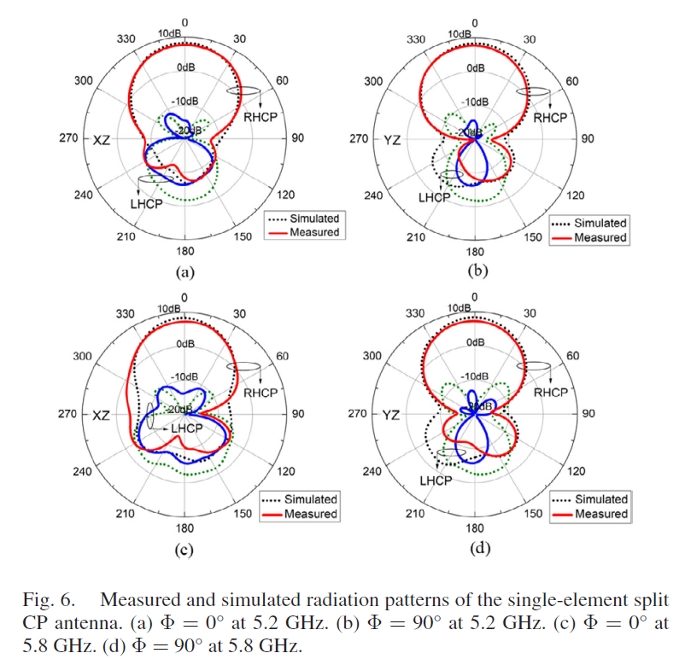
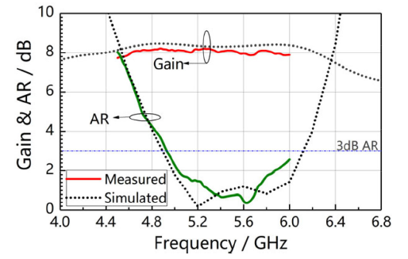
Patch Antenna with Slot (Unidirectional, 2 Layers) (2/2)
Wideband Circularly Polarized Split Patch Antenna Loaded With Suspended Rods, 2021

Slide 11
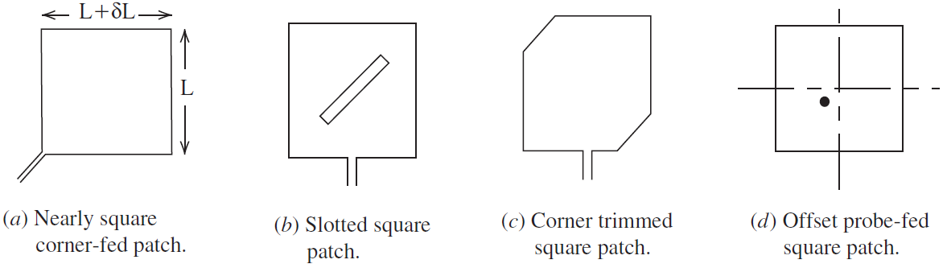
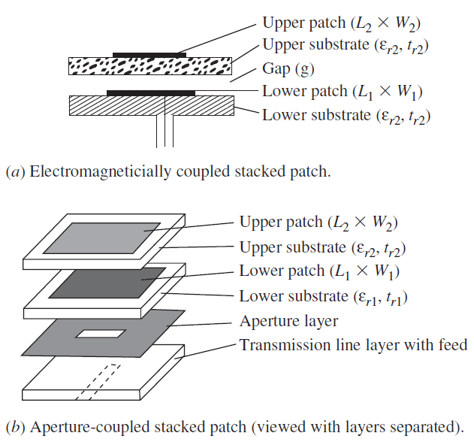

Patch Antenna (Antenna Theory and Design – Stutzman)
w/ power divider & phase shifter → BW ↑, size ↑; w/o PD & PS → BW ↓, size ↓
Lossy material → BW ↑, radiation efficiency ↓
Larger $ε_{r}$ → size ↓, e.g. ceramics for GPS patch antenna
End-launch or probe-fed
Fig.1 Microstrip antennas for generating circular polarization
Fig. 2 stacked-patch microstrip antennas for broadband operation

Slide 12
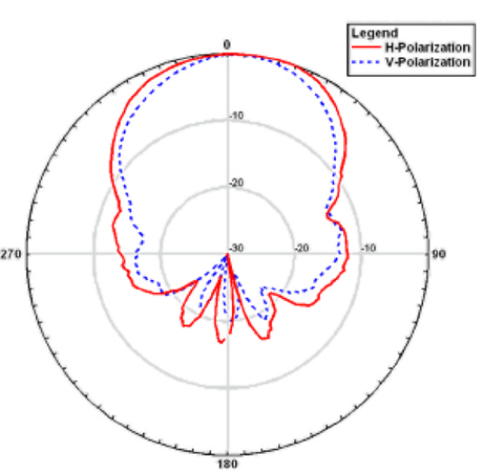
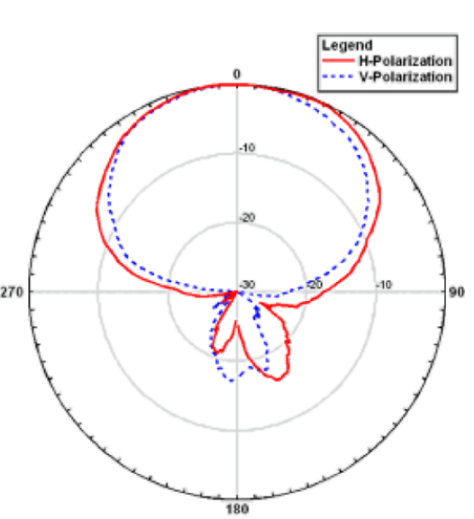
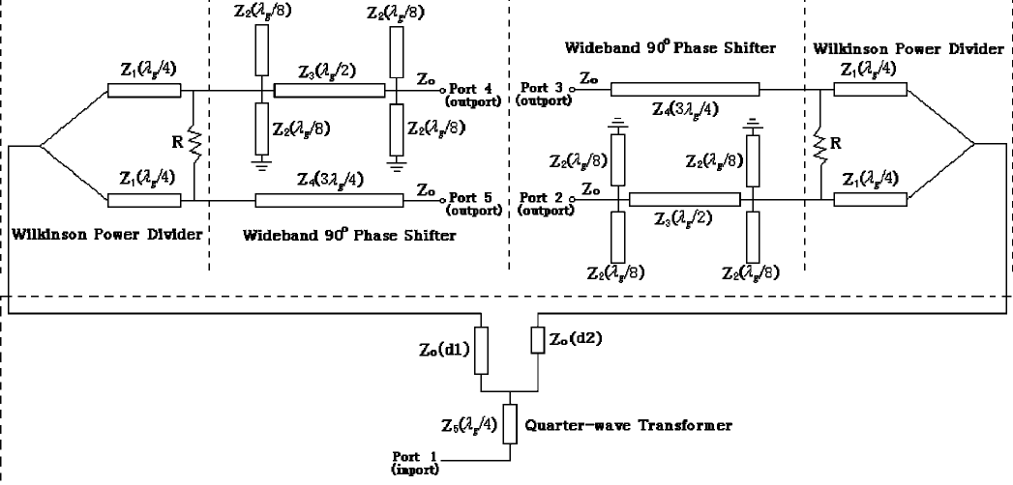
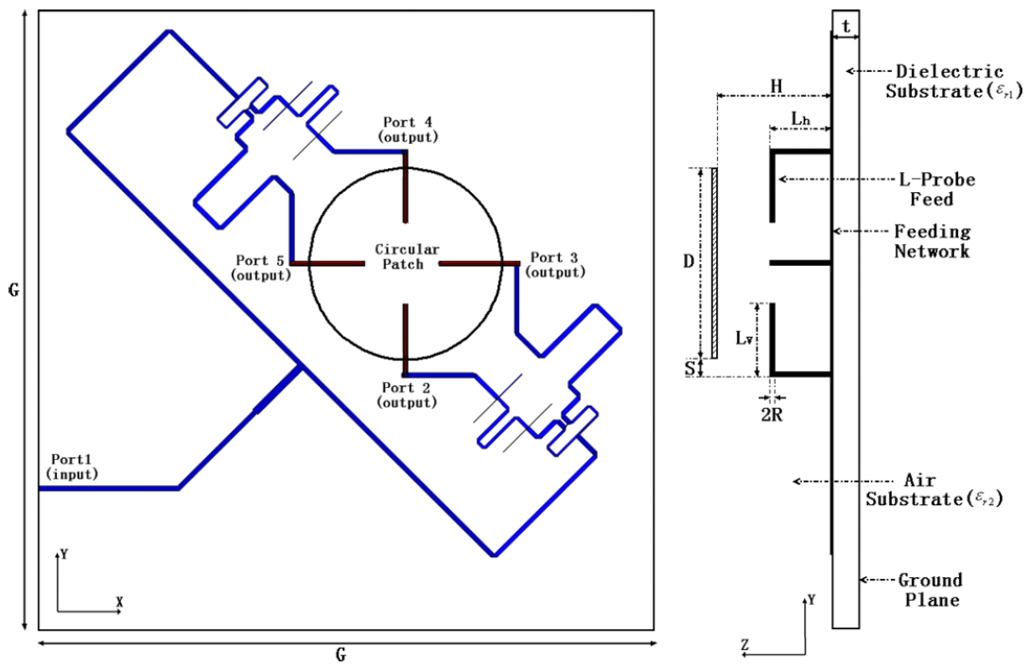
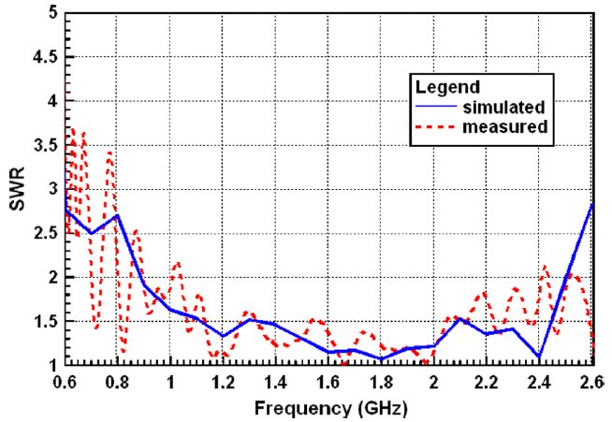
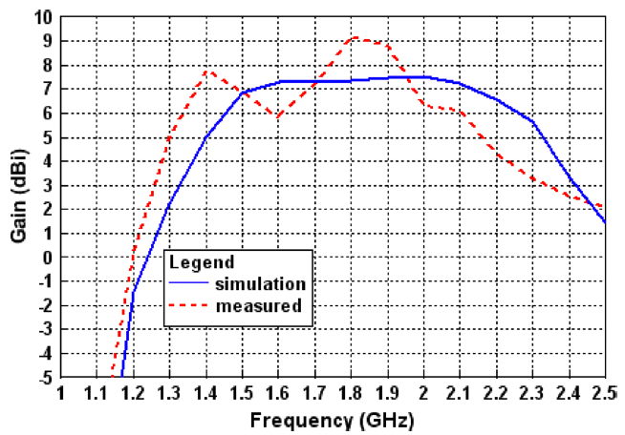
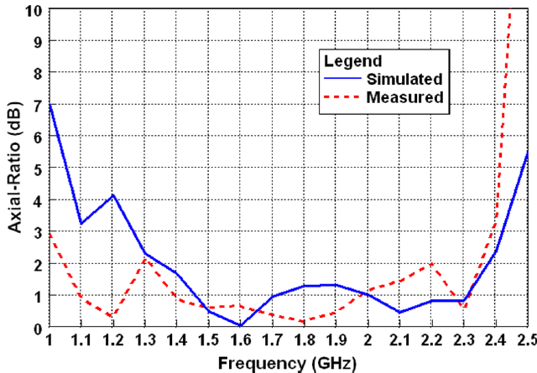

Patch Antenna (w/ Power Divider)
Wideband Circularly-Polarized Patch Antenna, 2006
Gain: 9 dBi, Impedance BW ($SWR<2$): 79.4%, 3 dB-AR BW: 82%
Symmetry → cancel out probe leakage radiation & probe coupling → suppress cross polarization & widen the impedance and AR BW

Slide 13
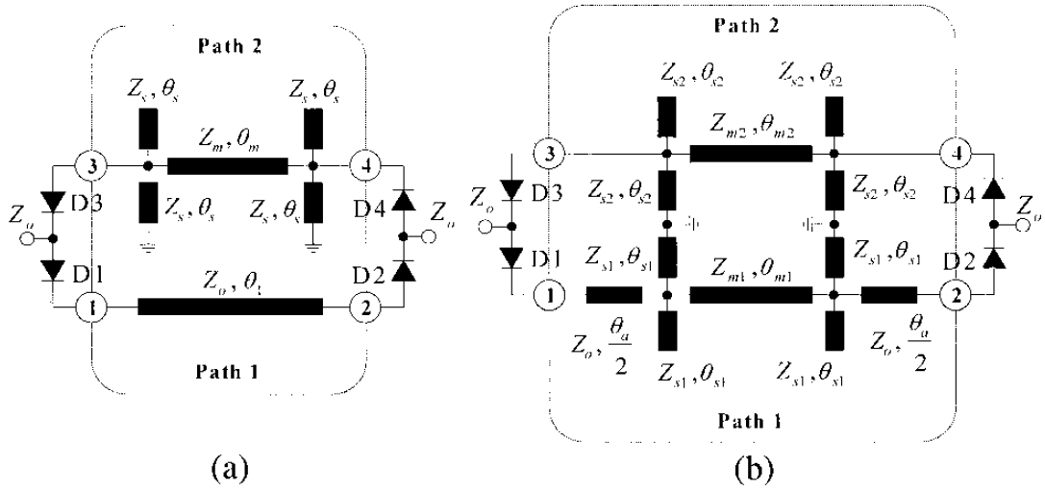
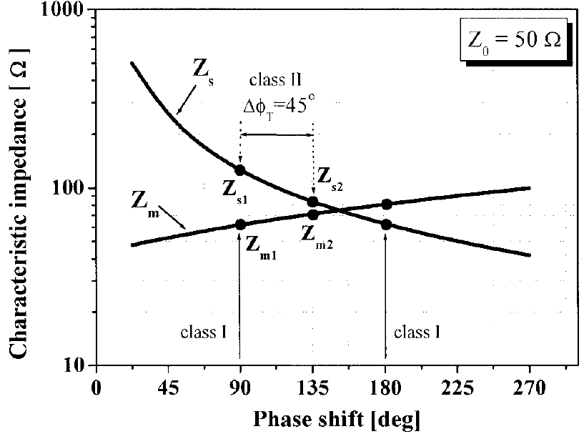

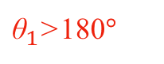
Wideband Phase Shifter
New switched-network phase shifter with broadband characteristics, 2003
λ/2
λ/8
${\text{θ}}_{1}$>180$°$
(a) is for PS > 9$0°$; (b) is for PS < 9$0°$
Phase slop is controlled by the value of $Z_{m}$ to $Z_{s}$

Slide 14
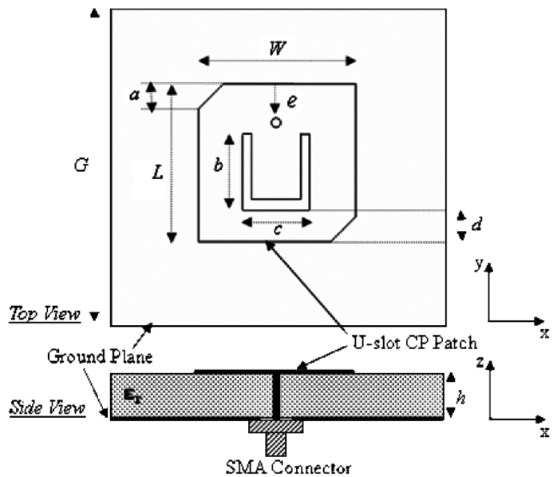
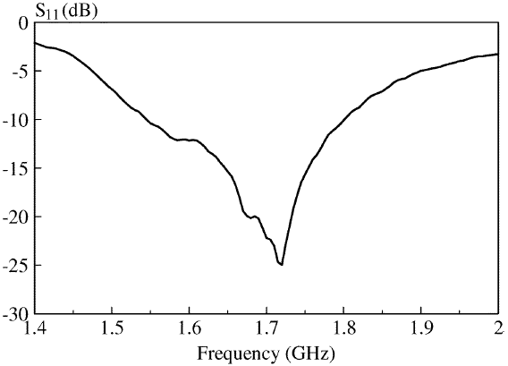
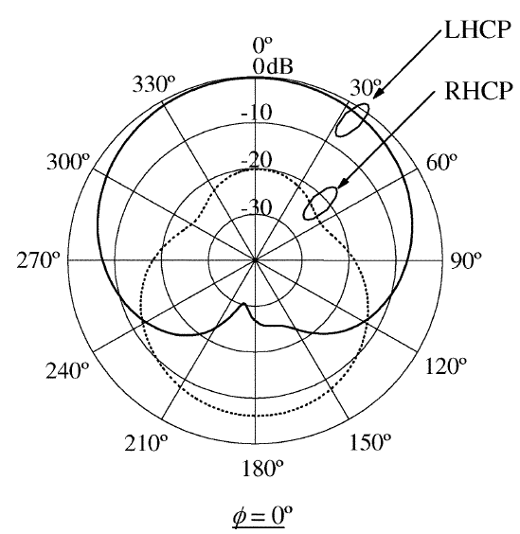
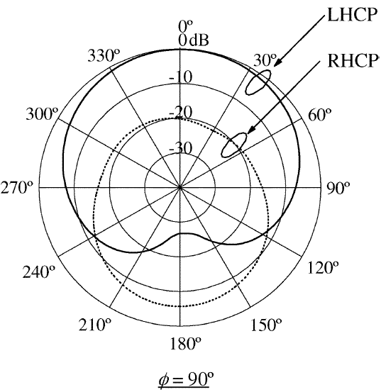
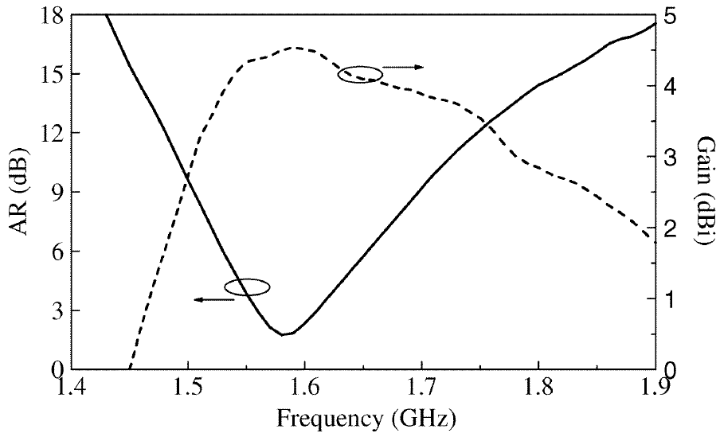
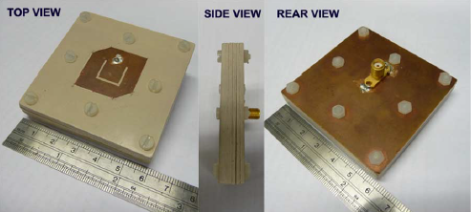
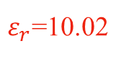

Patch Antenna (w/o Power Divider)
Small Circularly Polarized U-Slot Wideband Patch Antenna, 2011
Gain: 4.5 dBi, Impedance BW ($S_{11}$< -10 dB): 15.2%, 3 dB-AR BW: 3.2%
U-slot → capacitance → suppress the inductance due to the vertical feeding probe → enable the use of thicker substrates → impedance BW ↑
$ε_{r}$=10.02

Slide 15
Outline
Slot Antennas
Patch Antennas
Spiral Antennas
Loop Antennas
Monopole Antennas
Conclusions

Slide 16
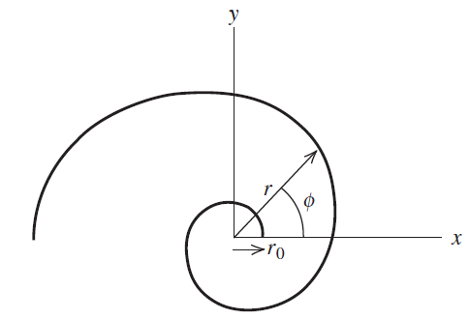
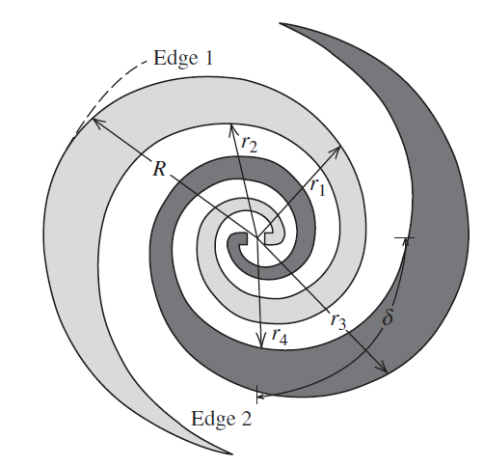
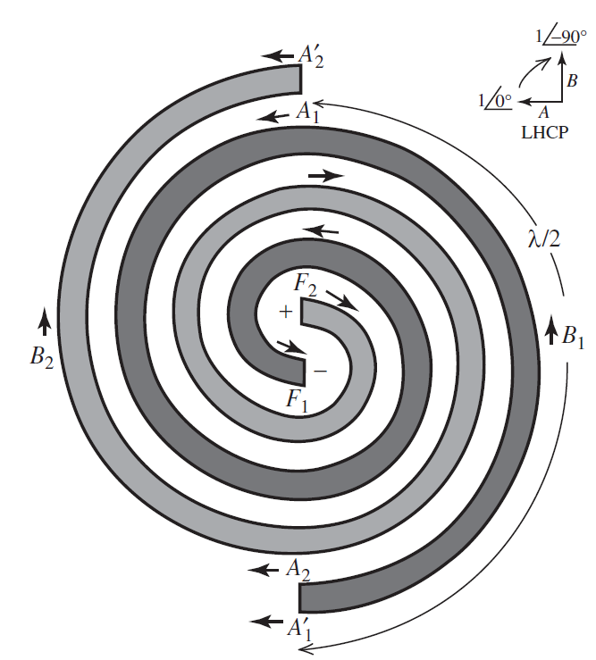


Spiral Antennas (Antenna Theory and Design – Stutzman)
Equiangular Spiral Antennas
$r=r_{0}e^{aφ}$
Self-complementary
Archimedean Spiral Antennas
$r=r_{0}φ$
$r=r_{0}(φ−π)$
Self-complementary & self-scaling
Frequency-independent

Slide 17
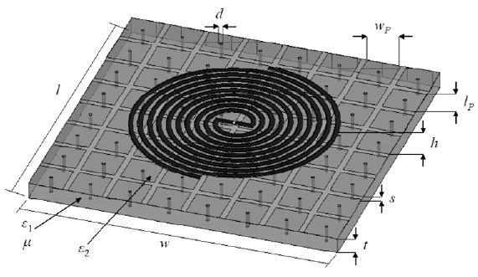
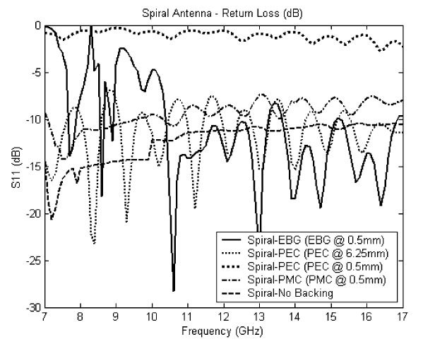
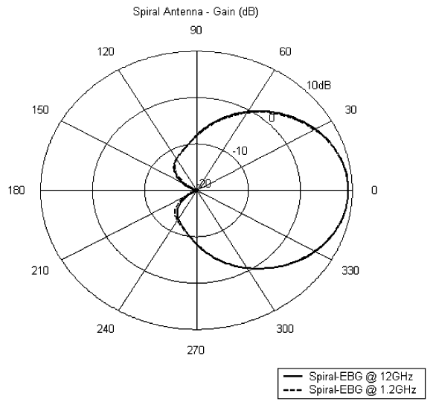
Spiral Antennas (Unidirectional)
Unidirectional beam: 1. λ/4 cavity 2. absorbing material 3. PMC
A low-profile Archimedean spiral antenna using an EBG ground plane, 2004
Height reduction: 69%, Gain: 9 dB, Bandwidth: 71%
Electromagnetic band-gap (EBG) structure with spiral antenna
0.5mm = λ/50
6.25mm = λ/4

Slide 18
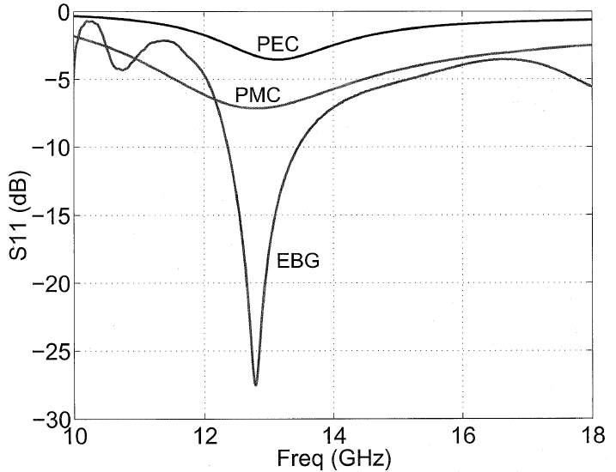


EBG Structure
PBG PMC and PEC ground planes, a case study of dipole antennas, 2000
Reflection phase characterizations of the EBG ground plane for low profile wire antenna applications, 2003
PEC: current cancels its image
PMC: current add up with its image,
but suffer from coupling problems
EBG: similar to PMC with good
matching if resonant f falls into the
band gap of the PBG surface
g → C
vias → L

Slide 19
Outline
Slot Antennas
Patch Antennas
Spiral Antennas
Loop Antennas
Monopole Antennas
Conclusions

Slide 20



Loop Antennas (Antenna Theory and Design – Stutzman)
One-wavelength circular/square loop antenna
Gain $≅$3.41 dB / 3.67 dB
With characteristic of a resonant antenna
Radiation pattern

Slide 21
Outline
Slot Antennas
Patch Antennas
Spiral Antennas
Loop Antennas
Monopole Antennas
Conclusions

Slide 22







Monopole Antennas (Bidirectional)
Broadband Circularly Polarized Printed Antenna With Branched Microstrip Feed, 2014
Gain: 2.6 dBic, Impedance BW ($S_{11}$< -10 dB): 73.0%, 3 dB-AR BW: 46.8%
Branch 1 → monopole
Branch 2 → slot
θ = 0°: odd mode → slot
θ = 90°: even mode → CPW TL → monopole

Slide 23







Monopole Antennas (Bidirectional)
CPW-Fed Wideband Circularly Polarized Printed Monopole Antenna With Open Loop and Asymmetric Ground Plane, 2014
Gain: 3.5 dBi, Impedance BW ($S_{11}$< -10 dB): 96.5%, 3 dB-AR BW: 63.3%
Asymmetric ground plane → CP; rectangular open loop → wide-impedance & AR BW

Slide 24
Outline
Slot Antennas
Patch Antennas
Spiral Antennas
Loop Antennas
Monopole Antennas
Conclusions

Slide 25

Conclusions
Gain (dBic) | 4.5 | 7.9 | $≅$4 | 8 | 9 | 4.5 | 9 | 2.6 | 3.5
impedance BW (%) | 90.2 | 29.67 | 1.6 | 48.75 | 79.4 | 15.2 | 71 | 73 | 96.5
AR BW (%) | 40% | 29.67 | < 1.6 dB | 22.58 | 82 | 3.2 | 71 | 46.8 | 63.3
direction | 2 | 1 endfire | 1 | Large back-lobe | 1 | Large back-lobe | 1 | 2 | 2

Slide 26
Conclusions
Gain (dBic) | 4.5 | 7.9 | $≅$4 | 8 | 9 | 4.5 | 9 | 2.6 | 3.5
impedance BW (%) | 90.2 | 29.67 | 1.6 | 48.75 | 79.4 | 15.2 | 71 | 73 | 96.5
AR BW (%) | 40% | 29.67 | < 1.6 dB | 22.58 | 82 | 3.2 | 71 | 46.8 | 63.3
direction | 2 | 1 endfire | 1 | Large back-lobe | 1 | Large back-lobe | 1 | 2 | 2

